Slide 1
Beyond Co-occurrence: Discovering and Visualizing Tag Relationships from Geo-spatial and Temporal Similarities
Date : 2012/8/6
Resource : WSDM’12
Advisor : Dr. Jia-Ling Koh
Speaker : I-Chih Chiu

Slide 2
Outline
Introduction
Discovering Tag Relationships
Experiments and Visualizations
Conclusion

Slide 3
Introduction
Existing approaches have largely relied on tag co-occurrences
But some related tags may seldom co-occur
Ex : the Statue of Liberty and Central Park
Both are major New York City landmarks
“statueofliberty”,”centralpark” it is nearly impossible to take a photo that includes both
o₁
o₂
o₃
t_{a}
t_{b}
o₄
…
o_{n}

Slide 4
Introduction
Motivation
How to find connections between tags by comparing their distributions over time and space
Goal
To cluster the tags based on their geo-spatial and temporal properties

Slide 5
Outline
Collection of tagged object
Geo-spatial feature vectors
Temporal feature vectors
Geo-temporal feature
Co-occurrence feature
Introduction
Discovering Tag Relationships
Experiments and Visualizations
Conclusion

Slide 6
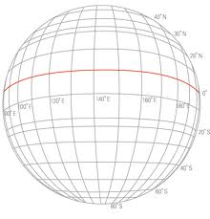
Geo-spatial feature vectors
The distribution of photographs over the world is highly non-uniform by raw geo-tags
Divide the world into n bins, each with s degrees of latitude by s degrees of longitude
Use s = 1 degree, which corresponds to grid cells of roughly 100 km x 100 km at the middle latitudes
Notes:
Because the distribution of photographs over the world is highly non-uniform, with most of the photographic activity concentrated in cities, many areas of the world have very few photos. It is thus useful to aggregate photos together into coarse geospatial buckets instead of clustering using raw geo-tags.
Note that the bins do not have the same surface area because degrees of longitude became closer together near the poles; this tends not to be a problem in practice because the vast majority of photos are taken near the middle latitudes.

Slide 7
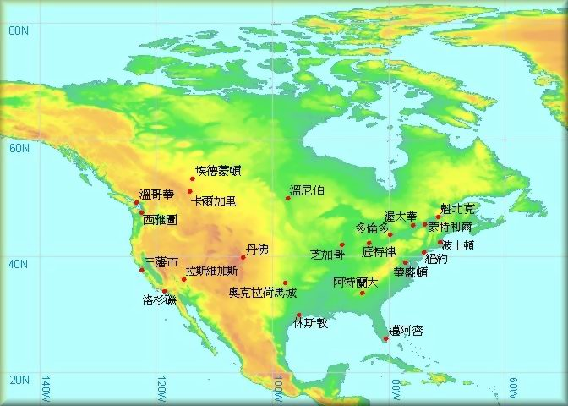
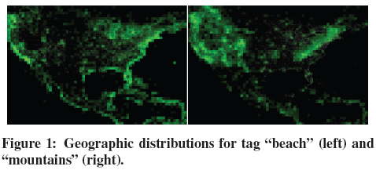
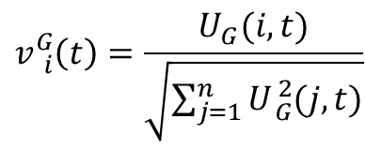
Geo-spatial feature vectors
(user,tag,time,geo)
Ex : beach
60N,80W → bins : 4800(index:1~n)
$U_{G}\left(100,beach\right)$
$$v{}_{i}^{G}{\left(t\right)=\frac{U_{G}(i,t)}{\sqrt{\sum_{j=1}^{n}{U{}_{G}^{2}{(j,t)}}}}}$$

Slide 8

Temporal feature vectors
Tags also have different temporal distributions
EX : “beach”, ”restaurant”
26-dimensional 2-week vectors
7-dimensional day-of-week vectors
24-dimensional hour-of-day vectors
Index : 1~m
$$v{}_{i}^{T}{\left(t\right)=\frac{U_{T}(i,t)}{\sqrt{\sum_{j=1}^{m}{U{}_{T}^{2}{(j,t)}}}}}$$
Notes:
because some tags (and semantic concepts) are much more popular at certain times than others

Slide 9
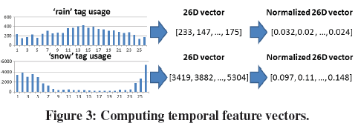
Temporal feature vectors

Slide 10
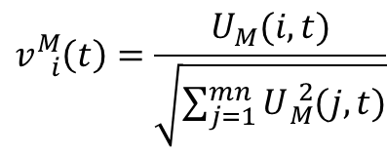
Geo-temporal (motion) features
How the geo-spatial distribution of the tag varies over the course of a year
Given geo and temporal quantization functions $q_{G}$ and $q_{T}$
Bin index : 1~mn
$$v{}_{i}^{M}{\left(t\right)=\frac{U_{M}(i,t)}{\sqrt{\sum_{j=1}^{mn}{U{}_{M}^{2}{(j,t)}}}}}$$

Slide 11
Co-occurrence features
The pairwise co-occurrence between two tags t1 and t2, co_occur(t1, t2)
Mutual information
$$MI\left(x,y\right)=p(x,y)\log{(\frac{p(x,y)}{p\left(x\right)p(y)})}$$
Ex : dataset : 1000 , x : 600 , y : 700
1. x$∩$y = 420 → p(x,y) = p(x)p(y) : statistical independence
2. x$∩$y > 420 → p(x,y) > p(x)p(y) : positive correlation
3. x$∩$y < 420 → p(x,y) < p(x)p(y) : negative correlation

Slide 12
Outline
Introduction
Discovering Tag Relationships
Experiments and Visualizations
Conclusion
Tag relationships
Clustering tags
Evaluation

Slide 13
Dataset
Collect nearly 80 million photos
Selected only the photos in North America
Computed the top 2000 most frequent text tags
Each tags has been used by at least 1,100 unique users

Slide 14
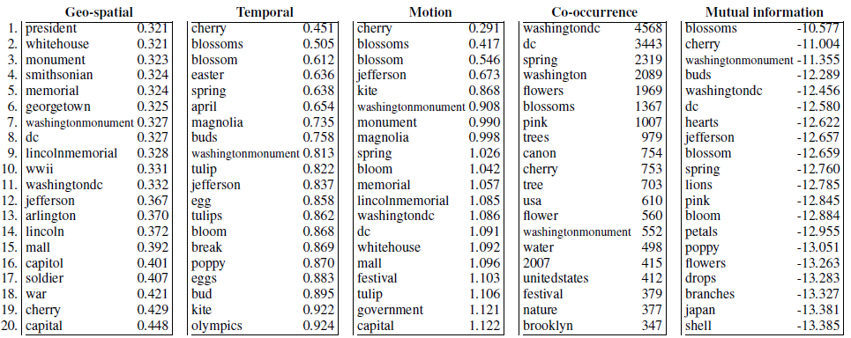
Tag relationships
Missed tags :
“whitehouse”,“april”
Compute the pairwise Euclidean
distances between these vectors
co_occur(t, t’)
mutual_info(t, t’)
Notes:
including geo-spatial, temporal, and geo-temporal.

Slide 15
Clustering tags
To cluster the 2000 tags using k-means
Since k-means clustering is sensitive to the initial choice of centroids
With different random initial cluster centers : 5 times
Set k = 50
Clustering the following data into 2 clusters using k-means
2, 5, 7, 8, 10, 16, 18, 20
Initial centroid : 2, 20
2: 2,5,7,8,10 → 6.4 :2,5,7,8,10
20: 16,18,20 → 18: 16,18,20
Initial centroid : 2, 5
2: 2 → 4.6 : 2,5,7,8
5: 5,7,8,10,16,18,20 → 14.8 : 10,16,18,20
Notes:
除了算出相似程度外，還要進一步地視覺化、量化其效能

Slide 16
Clustering tags
Measure the peakiness of a vector v by computing its second moment
Example :
Assume : After geo clustering ,there were three tags in a group
{sea ,beach , shearwater}
sea <0.9 ,0.05 ,0.05> → <0.81 ,0.0025, 0.0025>
Beach <0.8 ,0.05 ,0.15> → <0.64 ,0.0025 ,0.0225>
shearwater <0.95 ,0 ,0.05> → <0.9025 ,0 ,0.0025>
$$\frac{<2.3525 ,0.005 ,0.027>}{3}=<0.784 ,0.0016 ,0.009>$$

Slide 17
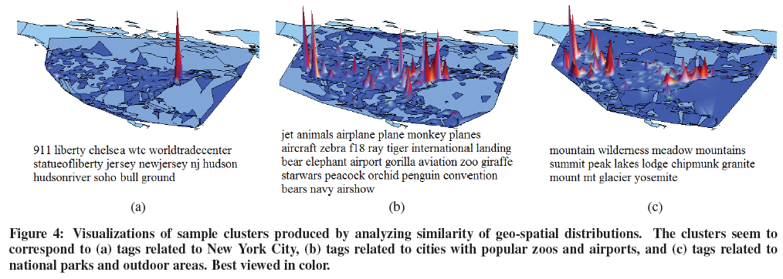
Geo-spatial clusters

Slide 18
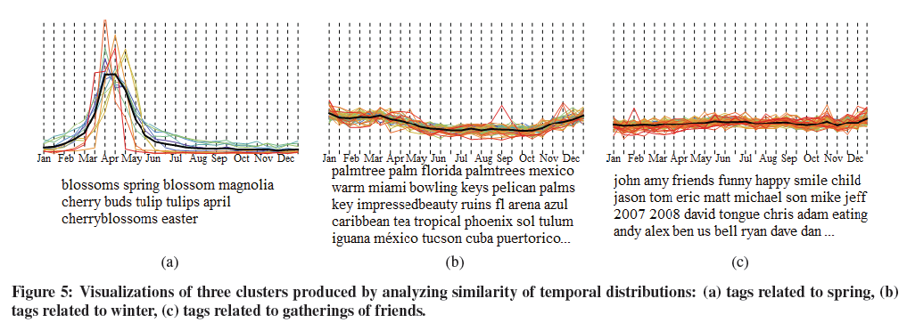
Temporal clusters

Slide 19
Evaluation
Define the quality of a tag cluster → difficult
Experiment → humans judge
Goal : To test whether these techniques produce coherent tag clusters that correspond to intuitive geo-spatial and temporal concepts
Try to measure how well these visualizations could help people appreciate subtle semantic connections between tags.
Notes:
藉由之前的計算相似程度的方法來進行不同features的分群
因為要定義分群結果的好壞是很困難的

Slide 20
Evaluation results
Geo relevant
Temporally relevant
Geo clusters | 29(58%)
Motion clusters | 30(60%)
Co-occurrence clusters | 11(22%)
Mutual information clusters | 11(22%)
Temporal clusters | 13(26%)
Motion clusters | 5(10%)
Co-occurrence clusters | 1(2%)
Mutual information clusters | 6(12%)

Slide 21
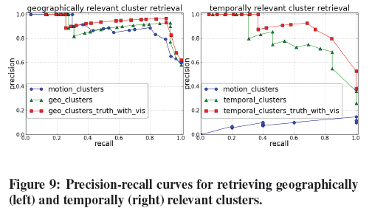
Geo and temporally relevant cluster retrieval
Dataset : 5000 data
500 item related to data mining
User gives a query “data mining”, system retrieves 2000 data,
400 data related to data mining
Precision = 400/2000 = 0.2
Recall = 400/500 = 0.8

Slide 22
Outline
Introduction
Discovering Tag Relationships
Experiments and Visualizations
Conclusion

Slide 23
Conclusion
Proposed techniques to measure the semantic similarity of tags by comparing geo-spatial, temporal, and geo-temporal patterns of use
Proposed novel methods to visualize the resulting clusters

Slide 24
Future work
Using only North American data and clustering the top 2000 most used tags into 50 clusters
It would also be interesting to build a tag recommendation system that integrates these techniques
Their approach could be applied to other collections of objects with geographical and temporal attributes, such as data from Wikipedia or Twitter

